Slide 1

Introduction
Intermediate code is the interface between front end and back end in a compiler
Ideally the details of source language are confined to the front end and the details of target machines to the back end.
Intermediate code
Static Checker
Intermediate Code Generator
Code Generator
Parser
Front end
Back end

Slide 2
CONT….
Although a source program can be translated directly into the target language. Some benefits of using a machine-independent intermediate form are-
Retargeting is Facilitated: A compiler for a different machine can be created by attaching a back end for the new machine to an existing front end.
A machine-independent code optimizer can be applied to the intermediate representation.

Slide 3
Why intermediate code ??
4 source language
4 source language
3 target machines
3 target machines
Intermediate code optimizer
4 front ends+ 4*3 optimizers+
4*3 code generators
4 front ends+
1 optimizers+
3 code generators

Slide 4
Different type of Intermediate co de
Intermediate code must be easy to produce and easy to translate machine code.
A short of universal assembly language.
Should not contain any machine specific parameters(register, address, etc.)
The type of the intermediate code deployed is based on the application. They are-
Quadruples, Triples, Indirect Triples, Abstract Syntax tree are the classical form used for machine
independent optimizations and machine code generation.
Static Single Assignment(SSA) is a recent form and enables more effective for conditional constant propagation and global constant variables.
Program Dependence Graph(PDG) is useful in automatic parallelization, instruction scheduling and software pipelining.

Slide 5
Three address code
Three address code is built from two concept- address and instructions. OR
In object oriented terms, these concepts correspond to classes, and the various kinds of addresses and instructions correspond to appropriate subclasses.
An address can be one of the following-
A name- For the convenience, we allow source- program names to appear as address in three –address code. In an implementation, a source name is replace by the pointer to its symbol table entry.
A constant- various type of constants and variables.
A compiler-generated temporary- Its useful, especially in optimizing compilers, to create a distinct name each time temporary is needed.

Slide 6
Cont.…..
Three address code is a generic form and can be implemented as quadruples, triples , indirect triples, tree or DAG.
And instruction are very simple i.e. a=b+c , x=-y, if a>b goto L1 , x=y etc.
Here, LHS is the target and RHS has at most two source and one operator.
Example- t1= b*c t2=a+t1 t3=b*c t4=d/t3 t5=t2-t4
a+b*c-d/(b*c)

Slide 7
Cont.……
Quadruples:- Its also called quad for simplicity, uses a record structure with four fields namely, OP, ARG1, ARG2, and RESULT.
Triples:- it’s a alternative representation of three- address statements, which saves one completes field present in the quadruples. This avoid entering temporary names into the symbol table, an obvious optimization in space.
Indirect Triples:- another implementation of three address code maintains array of pointers to triples rather than listing the triples themselves. This implementation is called indirect triples because of the nature to reference triples indirectly.

Slide 8
Cont.…
Advantage of indirect triples
The pointer are smaller than the triples and hence move faster. And this could be used for quads and many other recording applications(e.g Sorting large records).
Since the triples do not move, the reference they contain to past result remain accurate.

Slide 9
Cont..
3 address
1 t1= b*c
2 t2=a+t1
3 t3=b*c
4 t4=d/t3
5 t5=t2-t4
Quadruples
0
1
2
3
4
op arg1 arg2 Result * b c t1 + a t1 t2
* | b | c | t3
/ | d | t3 | t4
- | t2 | t4 | t5

Slide 10
Cont.….
Triples
0
1
2
3
4
op arg1 arg2 * b c + a (0)
* | b | c
/ | d | (2)
- | (1) | (3)
Indirect Triples
op arg1
STMT
arg2
0
1
2
3
(10)
* b
(11) + a
* b
/ d
(14) - (11)
(10)
c
(11)
(12)
(13)
(10)
c
(12)
⁴ (14)
(13)

Slide 11
+
/
+
/
d
*
*
a
d
*
a
b
c
b
c
b
c
DAG
Syntax tree

Slide 12
Instruction of 3-address code-1
1. Assignment instructions
a=b biop c, a= uop b, and a=b(copy) Where,
biop is any binary arithmetic, logical or relational operator.
uop is any unary arithmetic (-, shift, conversion) or logical operator (~).
Conversion operators are useful for converting integers to floating point numbers, etc.
2. Jump instructions
goto l (unconditional jump to l),
If t goto l(if t is true then jump to l),
If a relop b goto l (jump to l if a relational operation b is true). Where,
L is the label of the next three address instruction to be executed. t is a Boolean variable either 0 or 1.
a and b are either variable or constants .

Slide 13
Cont.….
Functions
func begin <name> (beginning of the function)
func end (end of function )
param p (place a value parameter p on stack) refparam p (place a reference parameters p on stack). call f, n (call the function f with n parameters )
return (return rom a function).
return a(return from a function with a value a )
Index copy instructions a=b[i] (a is set to contents)
where, b is usually the base address of an array.
a[i]=b (ith location of array a set to b).
Pointer assignments
a= &b (a is set to the address of b, i.e. a points to b).
*a= b (contents (contents(a) is set of contents(b))).

Slide 14
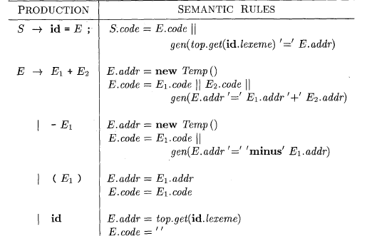
Translation of Expressions
1.Operation with expressions

Slide 15
Cont.
Attributes S.code and E.code denote the three address code respectively and attribute E.addr(temp) denotes the address that will hold value of E.
When E◊ (E1), the translation of E is the same as that of sub-expression E1.
If E1 is computed into E1.addr and E2 is computed E2.addr, then E1+E2 translate into t=E1.addr+E2.addr, where t is temporary name and then E.addr set to t.
The translation of E◊ -E1 is similar, the rules create a new temporary for E and generate an instruction to perform the unary minus operation.
Finally, production of E◊ id=E; generates instructions that assign the value of expression E to identifier id. Top.get determine the address of the identifier represented by id.
And an assignement to the address top.get(id.lexeme) for instance of id.

Slide 16
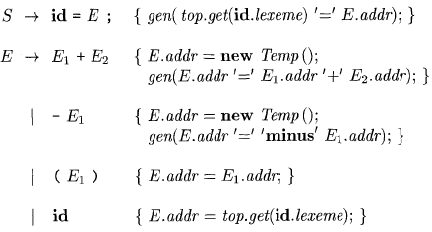
2.Incremental Translation

Slide 17
Cont…..
Cod attribute can be quite long stings so instead of building up E.code we can arrange generate only the three address instructions.
In incremental approach, gen not only constructs a three address instructions , it appends the instruction to the sequence of instructions generated so far.
The sequence may either be retained in memory for further processing or it may be output incrementally.

Slide 18
3. Addressing Array Elements
Generally array elements are start from o,1,2,…..,n-1.
If the width of each array element is w , then the i^{th} of element of array A begins with location.
base+i*w
base is relative address(A[0]).
The relative address A[i1][i2] is base + i1*w +i2*w2
Alternatively,
base + (i1+n2+i2)w
Where n number of element in array.
Where

Slide 19
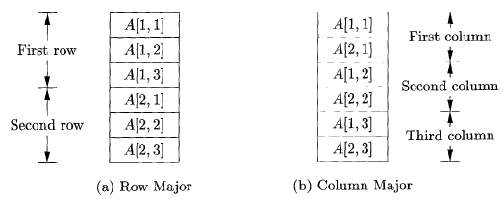
Cont..
Layouts for a two-dimensional array:

Slide 20
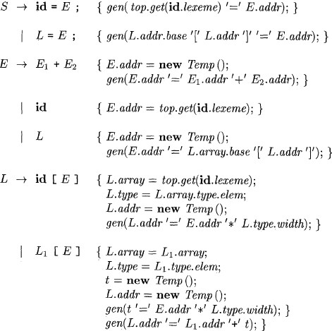
4. Translation of array reference

Slide 21
Cont..
L.addr denotes a temporary that is used while computing the offset for the array reference by summing the terms ij * wj .
L.array is a pointer to the symbol table entry for a array name , l.array.base is used to determine the actual l-value of an array reference after all the index expressions are analyzed.
L.typw is the type of the subarray generated by L. for any type t, we assume that width is given by t.width. For any array type t , suppose that t.elem gives the element type.

Slide 22
example of c-program
int a[10], b[10], dot_prod, i; int * a1;
int *b1; dot_prod=0; a1=a;
b1=b;
For(i=0; i<10; i++)
dot_prod + = *a1++ * *b1++;
t5=*b1 t6=b1+1
b1=t6 t7= t3*t5
t8=dot_prod +t7 dot_prod=t8 t9=i+1
i=t9 goto L1
Intermediate code:-
dot_prod=0; a1= &a b1=&b
i=0
L1: if (i>=10) goto l2:
t3=*a1 t4=a1+1
a1=t4
L2:

